Slide 1
Bando Erasmus+ Tirocinio
a.a. 2024/25
LM in Legal Studies
23/04/2024
Emanuele Gaiba

Slide 2
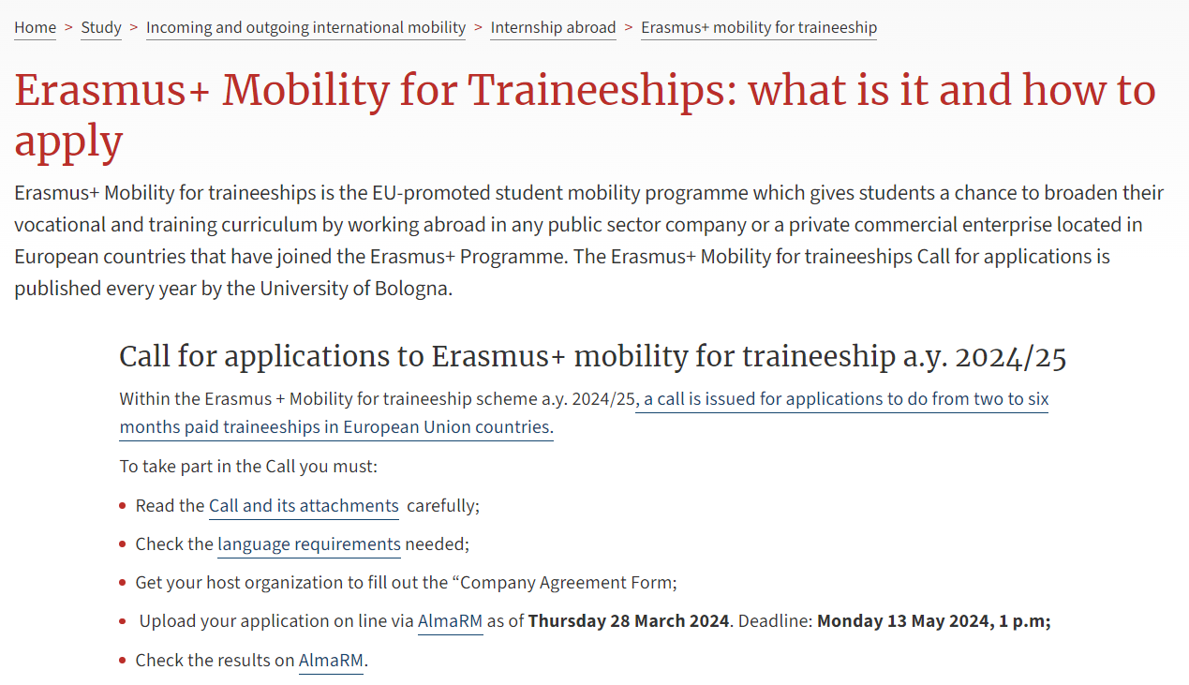
Erasmus+ Traineeship
Official Call for Application a.y. 24-25
https://www.unibo.it/en/study/international-experiences/internship-abroad/erasmus-mobility-for-traineeship/erasmus-mobility-for-traineeships-what-is-it-and-how-to-apply/erasmus-mobility-for-traineeships-what-is-it-and-how-to-apply

Slide 3
Erasmus+ Traineeship
What is Erasmus+ Traineeship programme?
The programme gives students a chance to carry out a traineeship with a business, training centre, university, research centre or other organization in countries belonging to the Programme
Countries where traineeships may be performed
the 26 European Union member states;
the 3 countries of the European Economic Area (Iceland, Liechtenstein, Norway);
the 3 candidate members (Macedonia, Serbia, Turkey).
United Kingdom and Switzerland
NB. Mobilities at universities/higher education institutions in United Kingdom and Switzerland are not eligible.

Slide 4
Erasmus+ Traineeship
Length of the traineeship
The traineeship may last from 2 to 6 months. Minimum length: 60 days
The financial contribution covers the chosen duration.
The traineeship may begin on any date between 1st of September 2024 and it must end by 31 July 2025, on penalty of the contribution being withdrawn.
The traineeship must run without interruption or pauses.
It will be possible, once the traineeship is began, to extend the duration of the programme and check possible funding.

Slide 5
Erasmus+ Traineeship
Financial Contribution
European Union funding for Erasmus+ Mobility for Traineeships differs according to the destination country, as in the following table:
Student who are ranked as eligible (IDONEI) without receiving the grant might ask for Erasmus zero-EU grant status, which allows them to obtain the mobility benefits, but without receiving the EU grant.
GROUPS | COUNTRIES | MONTHLY AMOUNT
group 1 (high cost of living) | Denmark, Finland, Ireland, Iceland, Liechtenstein, Luxembourg, Norway, United Kingdom, Sweden, Switzerland, | 500 euros
group 2 (medium cost of living) | Austria, Belgium, Cyprus, France, Germany, Greece, Malta, Netherlands, Portugal, Spain. | 450 euros
group 3 (low cost of living) | Bulgaria, Croatia, Czech Republic, Estonia, Latvia, Lithuania, North Macedonia, Poland, Romania, Serbia, Slovakia, Slovenia, Turkey, Hungary. | 400 euros

Slide 6
Erasmus+ Traineeship
An additional contribution of € 250 per month is foreseen for candidates with ISEE 2024 declaration and/or the documentation concerning the income and asset situations (for international students whose nuclear family has income and/or assets abroad) for services for the right to higher education up to € 27.000,00.
This declaration must be submitted later on from winner students only according to the procedures and deadlines that will be communicated on the page: https://www.unibo.it/en/international/internship-abroad/erasmus-mobility-for-traineeship/erasmus-grant
Special funding for students with special needs that may be allocated by the European Union. Selected candidates will be informed directly about the availability of special grants for students with special needs.
A specific grant is foreseen for the so called “green travel”, that is for the travel towards host university with sustainable means of transportation (ex. buses, trains, etc.).

Slide 7
Erasmus+ Traineeship
Who can apply
Both students and new-graduates may apply according to the following rules:
Students must be enrolled in a.y. 23/24 and renew their enrolment for the 2024/25 academic year by the deadline established by the University.
New-graduates must be enrolled in a.y. 2023/24 for the last year of their study cycle and not yet have graduated by the deadline for this application procedure (13/05/2024).
Students may not be awarded their qualification before their mobility period ends, but must wait for their traineeship abroad to conclude.
By contrast, new graduates’ mobility period must start after their degree has been awarded as it is not possible to graduate during the mobility period.

Slide 8
Erasmus+ Traineeship
Eligibility conflicts
Erasmus+ mobility experiences and grants can be repeated up to a maximum of 12 months (360 days) per degree. Both study activities and traineeships are included in the 12 months. Prior mobility experiences under the Erasmus+ Programme counts towards the mobility period maximum of 12 months for each cycle. When submitting the application, the system will check prior mobility experience information which the University has on record.
Students who apply may not receive, during the same period, any other types of EU grants (ex. scholarships for Joint Master Degrees - pursuant to Erasmus Mundus Action 1) or grants allocated from the UNIBO funds available for mobility periods abroad;
Erasmus+ Mobility for Traineeships grantees can also receive other mobility abroad programmes promoted by University structures, including mobility programmes that will take place in the same academic year (ex. thesis abroad, Erasmus+ Study, Overseas, etc.) provided that these periods do not overlap, even partially.

Slide 9
Erasmus+ Traineeship
Language Requirements
Evidence of a minimum language level in the main language of the traineeship must be given in order to apply.
The minimum language level required to apply is B1
https://www.unibo.it/en/study/international-experiences/internship-abroad/erasmus-mobility-for-traineeship/erasmus-mobility-for-traineeships-what-is-it-and-how-to-apply/language-requirements-for-erasmus-mobility-for-traineeship
Knowledge of the foreign language must be proved in one of the following ways, all of which are deemed to be equivalent:
being enrolled on a degree programme entirely conducted in English (see Annex 2 – such as LEGS); such students may only use this as a language requisite if applying to firms which stipulate English as the traineeship language;

Slide 10
Erasmus+ Traineeship
Language Requirements
having passed one of the TESTs for the participation in this call for application at the University Language Centre held within April 2024 at the B1 level or above. To sit a test, one must enroll online via AlmaRM from 8 April 2024 12:00 p.m. to 12 April 2024 12:00 p.m. It is possible to sit the test only once and for a maximum of two languages;
having passed one of the TESTs at the University Language Centre (only if taken on or after 01/01/2021) for other calls for application for international mobility programmes (Erasmus+ for study, Erasmus+ for traineeship, Overseas, Fieldwork) at the B1 level or above;
having obtained abroad or in Italy a high school diploma or a first cycle degree in one of the following languages of traineeship stated in the Company Agreement Form: English, French, German, Spanish and Portuguese). Warning: the diploma must display the language in which the diploma/degree has been obtained;
having a certificate of adequate language abilities issued by the host organisation in the Company Agreement Form.

Slide 11
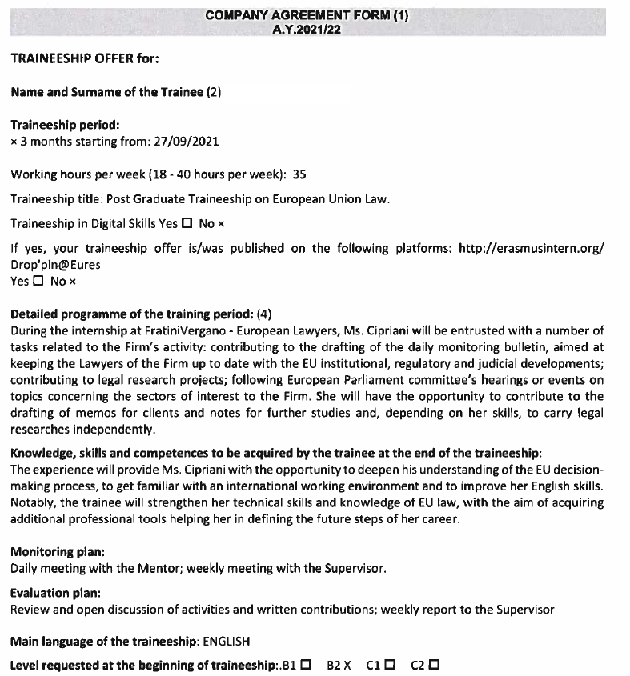
Erasmus+ Traineeship
Each candidate may submit only one application
Candidates find the host organisation independently and formulate the traineeship programme with said organisation, through the compilation and the signature of the Company Agreement Form (Annex 4).
Candidates must enter all company data and the traineeship proposal formulated by the host organisation on Alma RM according to the instructions contained in the file titled “Notes on filling in an application” and upload the Company Agreement within the deadline. The form must be filled in, signed and stamped by the company. Applications without Company Agreement Form will not be considered.
Traineeship programmes the candidate agrees with the host organization must be consistent with his/her studies.

Slide 12
Erasmus+ Traineeship
Candidates need to:
use the @studio.unibo.it credential
log in on AlmaRM
upload the following pdf:
Company Agreement Form
CV
Motivational letter
additional language certificate(s)
additional self certificate of 1° cycle degre programme (outside UNIBO)
additional titles and experiences abroad

Slide 13
Erasmus+ Traineeship
Selection criteria
Departments Committee’s assessment of (maximum 40 points):
traineeship project content (contained in the company agreement form) and its relevance to the candidate’s study curriculum, reasons for doing the traineeship, language proficiency any other factors mentioned by the student in his/her application
Educational career assessment (maximum 60 points) based on regularity of study and credits
All students must promptly check the data in the Studenti Online application concerning their own educational career, to ensure that all completed learning activities and exams have been recorded as at 29 May 2024 and can be used for the purposes of calculating their educational career evaluation scores.

Slide 14
Erasmus+ Traineeship
Potential Host Organizations
“any public or private organization active on the labour market or in sectors such as education, training, youth, research and innovation”.
That definition includes public and private companies (including social enterprises), training centers, schools (where students act as assistants abroad), universities and research centers, nonprofits, associations, NGOs, and other organizations.
If the traineeship is done at an institute of higher education (e.g., a university laboratory, university library, etc.), the activity must consist of vocational training and NOT study, and the training activity must be clearly stated in the work plan.
The following are NOT eligible as traineeship hosts:
EU institutions and other EU bodies including specialist agencies. For a complete list: http://europa.eu/about-eu/institutions-bodies/index_en.htm;
Organisations operating EU Programmes (to avoid conflicts of interest and/or double funding).

Slide 15
Erasmus+ Traineeship
How to find a company
It is actually a job search. Candidates must:
define in what field they want to carry out the traineeship, what language skills they have, what professional ambitions/interests they have, in which countries they would like to go.
research host organizations that fit their interests. Contact the host organizations directly with a CV, a specific letter of motivation (specifying the required period) and the description in English for the host organizations of the Erasmus+ program (this document is online among the documents useful to search for a traineeship independently)
Other tips:
ask Professors for some contacts or guidance
turn to the Mobilitas Service (see Annex 3)
consult the List of websites for sourcing traineeships (see Annex 3)

Slide 16
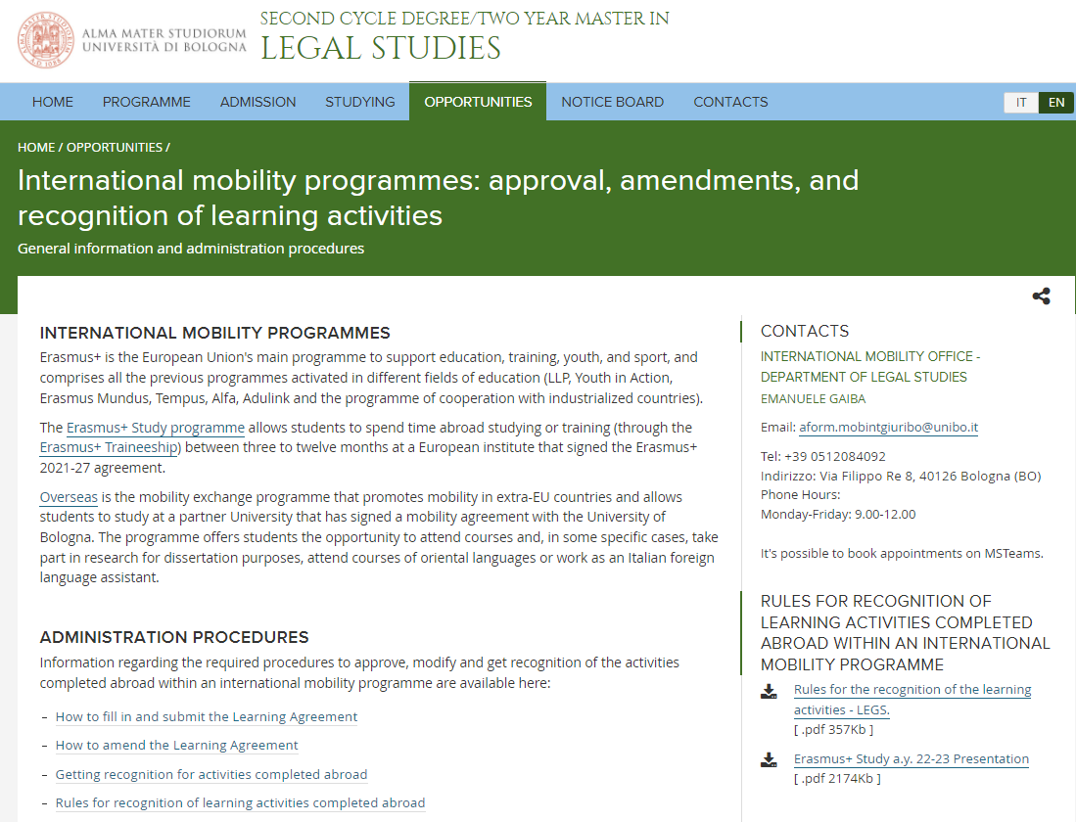
Erasmus+ Traineeship
https://corsi.unibo.it/2cycle/legal-studies/international-mobility-programmes-approval-amendments-and-recognition-of-learning-activities

Slide 17
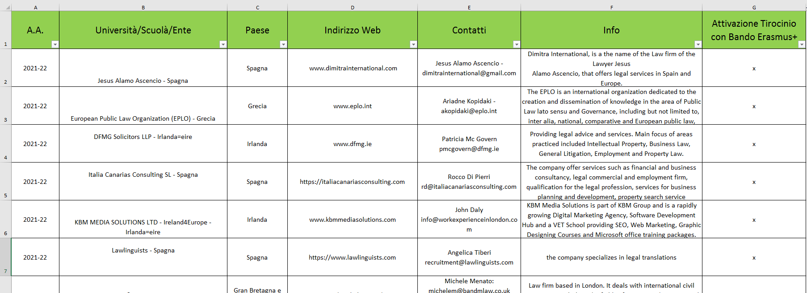
Erasmus+ Traineeship

Slide 18
Erasmus+ Traineeship
Getting your traineeship recognised
Students must follow the recognition procedure established in the regulations and course structure diagrams for their degree programme. It is possible to get credits recognition as long as an internship activity is planned in the study plan.
In particular, activities such as the INTERNSHIP can be taken abroad.
the INTERNSHIP can be cover for 6 credits, 12 credits or 18 (6+12) credits (covering the free choice activity of the second year) and according the length of your internship.
the student can include the INTERNSHIP ABROAD FOR PREPARATION OF THE FINAL EXAMINATION if the internship is related to the master thesis preparation-
The number of hours should match the number of credits of the activity (1 CFU equals 25 hours of work during the internship). Ex. 12 CFU = 300 hours; 40 hours/week are around 160 hours per month.
More information will be given to winner students by the time of submission of their Learning Agreement for Traineeship (LAT) later on.

Slide 19
Erasmus+ Traineeship
Entry to the host country
Students are responsible for learning about:
any rules concerning entry into the host country, promptly contacting the relevant diplomatic representatives in Italy;
healthcare by contacting their own healthcare board or the relevant diplomatic representatives.
Legislation and regulations governing the immigration of non-EU students in different countries depend on the nationality of the student. Students are responsible for obtaining all required information and the documents which will allow them to enter and stay in the destination country, by contacting the relevant diplomatic representatives. The procedure for obtaining a visa for European countries that do not belong to the SCHENGEN area (Bulgaria, Croatia, Cyprus, Ireland, Romania, the United Kingdom, Serbia) is particularly long and does not always result in a visa being issued. Non-EU students are therefore encouraged to consider this aspect when choosing the host organization.
In case of assistance get in touch with our internationaldesk@unibo.it
Visa /Health Insurance apply also for EU students going to the United Kingdom.

Slide 20
Erasmus+ Traineeship
Insurance coverage for civil liability and accidents in the workplace
Grant winners will be insured for civil liability (damage caused to third parties) and against accidents in the workplace by the University policy and/or through INAIL.
A dedicated and detailed guide regarding Health and safety during the activities carried out abroad by University students and staff is available here: https://www.unibo.it/en/study/life-at-university-and-in-the-city/health-and-assistance/health-and-safety/Health-and-safety-during-the-activities-carried-out-abroad-by-University-students-and-staff

Slide 21
CALENDAR
Language tests at the University Language Centre: from 8 April 2024 12:00 p.m.
to 12 April 2024 12:00 p.m.
Deadline for applying: 13 May 2024 1 p.m.
Ranking lists published on Alma RM: 20 June 2024
Deadline for winners to accept online via Alma RM:
27 June 2023
1st September 2024: beginning of the traineeship
31 July 2025: final conclusion for all traineeships

Slide 22
CONTACTS
Erasmus Placement Office
erasmus.placement@unibo.it
Via Filippo Re 4
40126 Bologna
International Mobility Office - Law
mobility.law@unibo.it
Via Filippo Re 8
40126 Bologna

